Slide 1


Pinecone
Vector Database
Build knowledgeable AI
Presented by Rick Jacobs
Technical Marketing Manager

Slide 2
Why use a vector database?
Pinecone Overview
Use cases
Demo
QA
Agenda

Slide 3
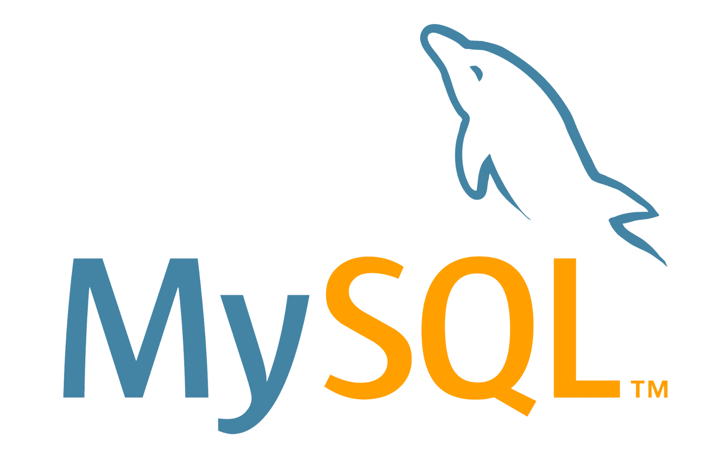
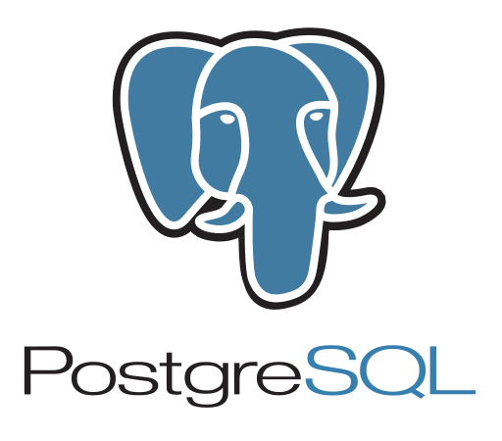



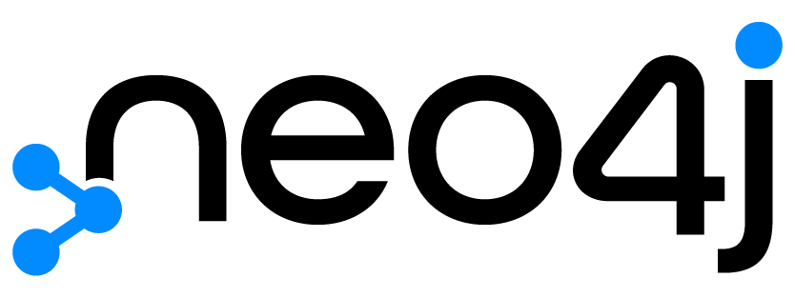
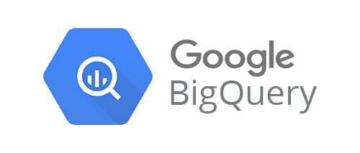







Why a vector database?
Data Platform Shift
Data type
Database
Mainframe to personal computer
Structured data
On-prem to cloud
Semi-structured
Predictive to generative
Vectors / Unstructured

Slide 4
Vectors: represent many dimensions
A vector is long list of numbers, each representing a dimension of the input data
[ 0.1, 0.6, 2.4, 1.8,...]
…
[ 0.2, 0.6, 3.1, 0.9,...]
We can graph x,y,z and conceptually think about x,y,z
It’s hard to conceptualise 1536 dimensions!
https://a16z.com/2023/06/20/emerging-architectures-for-llm-applications/

Slide 5
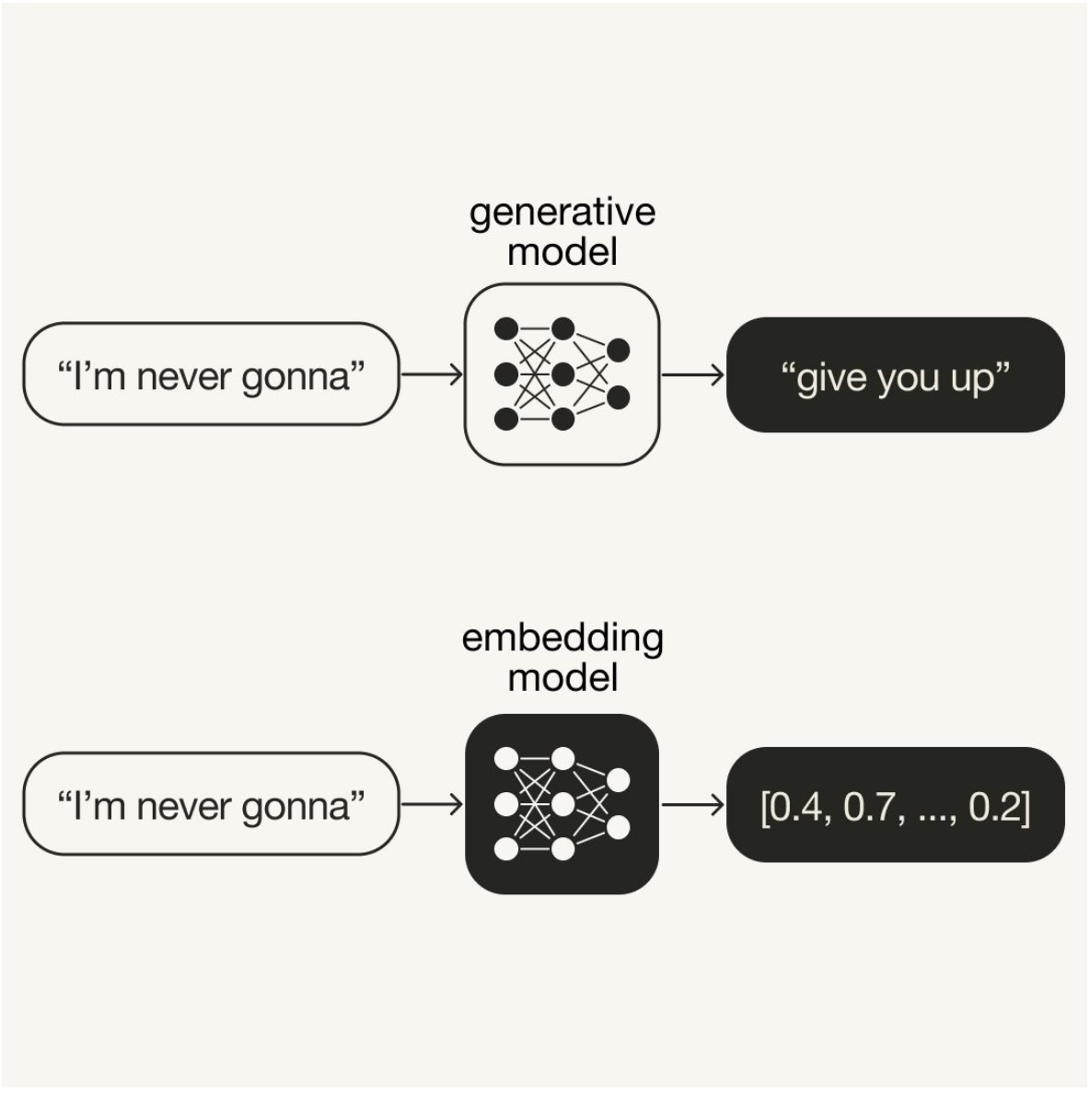
Embedding Model
LLMs:
take an input (prompt) and generate an output by predicting the next token
Embedding Models: take an input, and encode its “meaning” as a list of numbers

Slide 6
Finding Similarity
We know how to take data and characterise it as vectors via embedding
We know we can find how similar pairs of vectors are using distance metrics
= > We can take our input, convert it to a vector, then calculate distance to each of the vectors representing our source content
The most similar vectors are known as our Nearest Neighbours
If we calculate the distance for *every* vector, this is an exhaustive search, often referred to as a kNN search (k Nearest-Neighbour search)

Slide 7
Approximate Nearest Neighbour
Due to computational complexity of KNN algorithms, “ANN” (Approximate Nearest Neighbour) is used instead
Results are not guaranteed to be the exact or all nearest neighbours
Results have a similarity score
With the right algorithm, data structure, and architecture, ANN can enable similarity search against billions of vectors
All vector search solutions operating at scale utilise ANN solutions

Slide 8
About Pinecone

Slide 9





Established the category in 2019
Built by AI, search, and database experts
20+ years in research and commercializing search and scalable distributed AI systems across companies like AWS, Google, Splunk, and Databricks

Slide 10

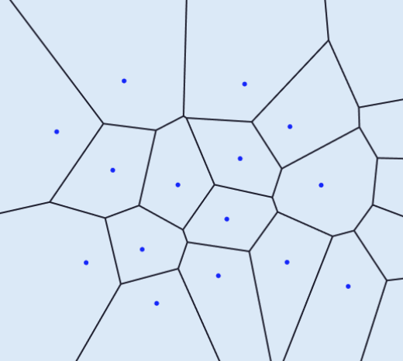

Serverless architecture
Application
Cloud-Native Architecture
De-coupled storage and compute plus auto-scaled read and write paths
Industry-First Adaptive Clustering Algorithm
Geometrically partitioned index with dynamic clustering
Cost-Effective Storage
Scalable blob storage for persistence and reliability
Freshness and Caching Layers
Reads and writes are cached to provide high-performance
Usage-Based Packaging
Only pay for reads, writes and storage
Multi-Tenant
100s of Millions of namespaces, 100s of Billions of vectors
Pinecone Serverless
Read Path
API Gateway
Write Path
In Memory
Query Router
Freshness
Layer
Log Writer
Object Storage
Geometrically Partitioned Index
Persisted Vectors
Index Builder
File
File
File

Slide 11

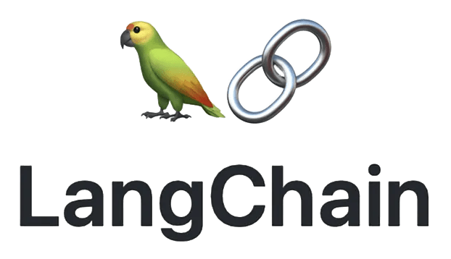
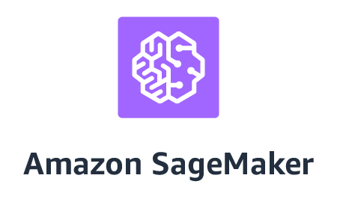
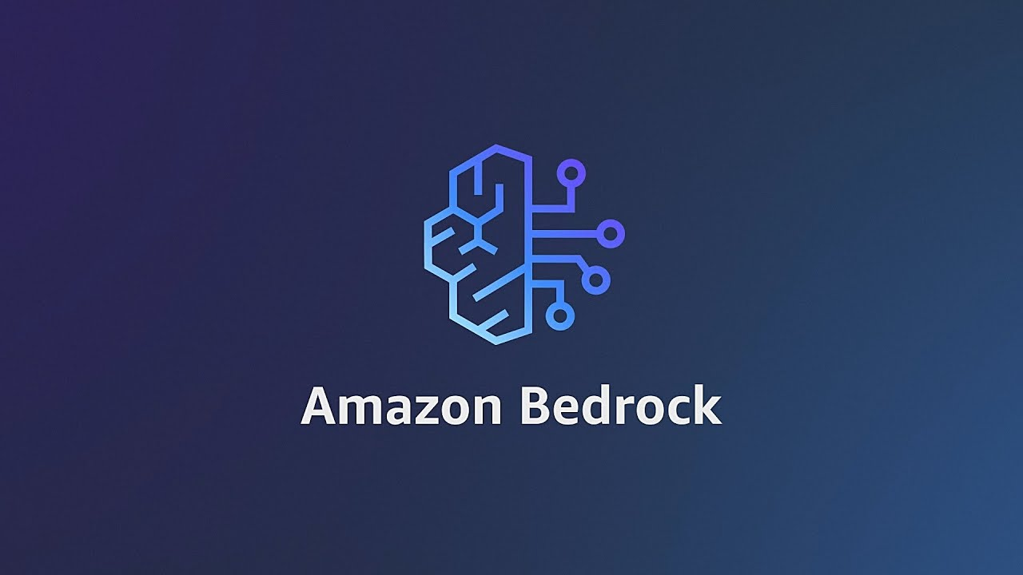
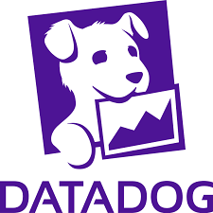



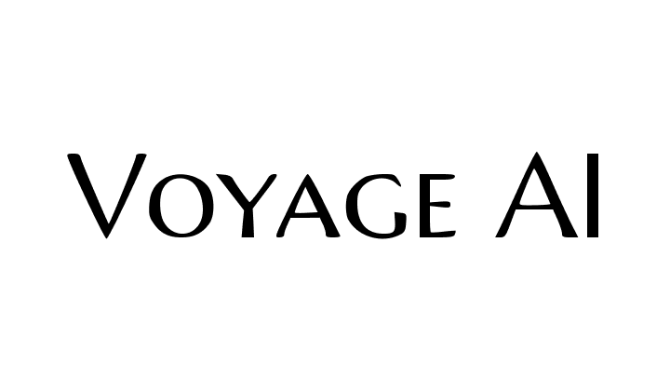

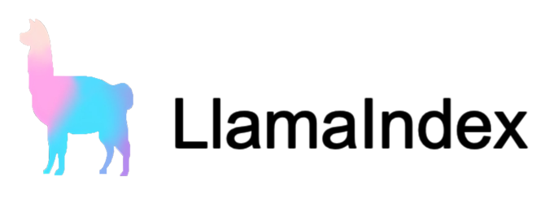


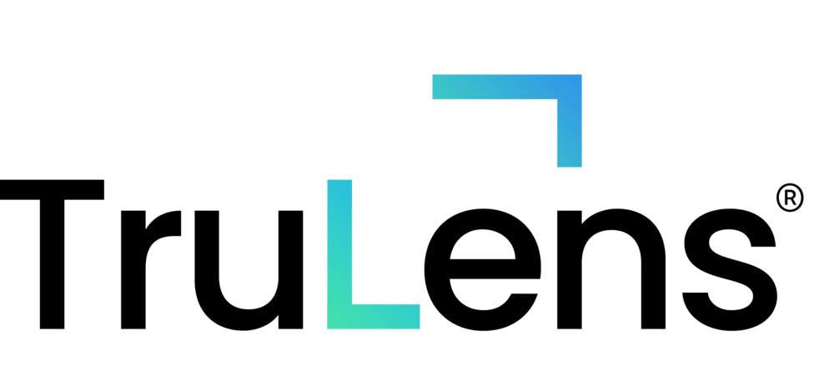





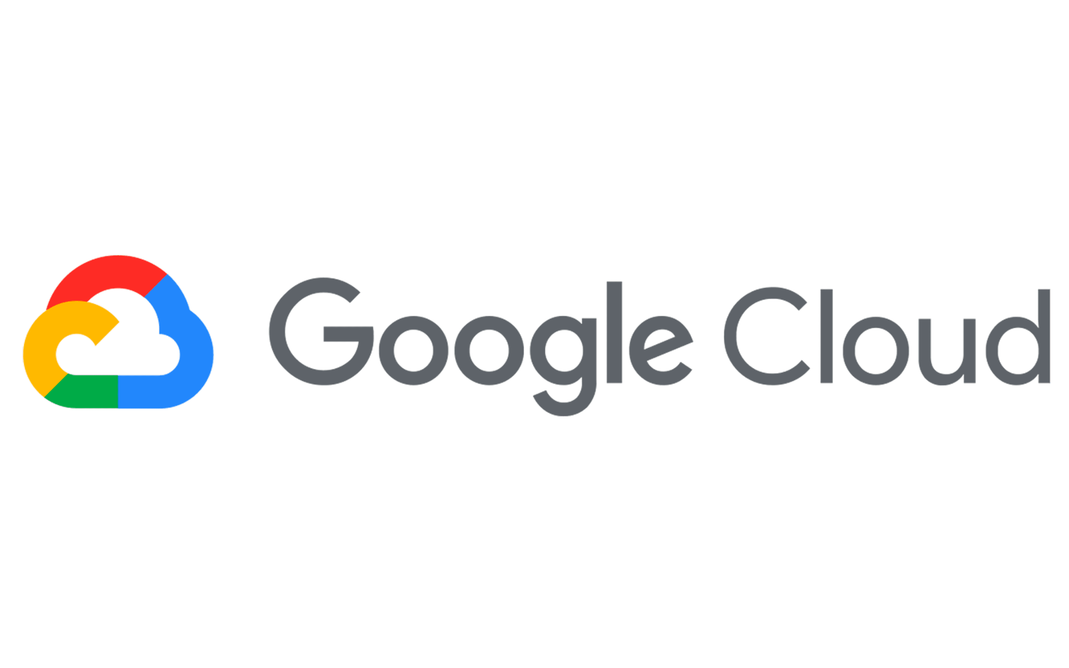
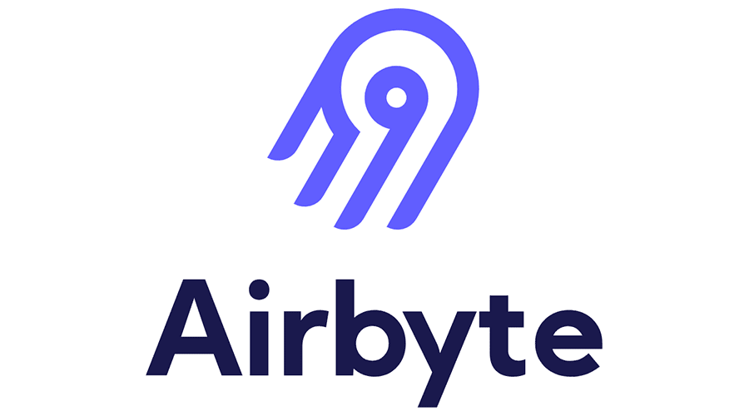

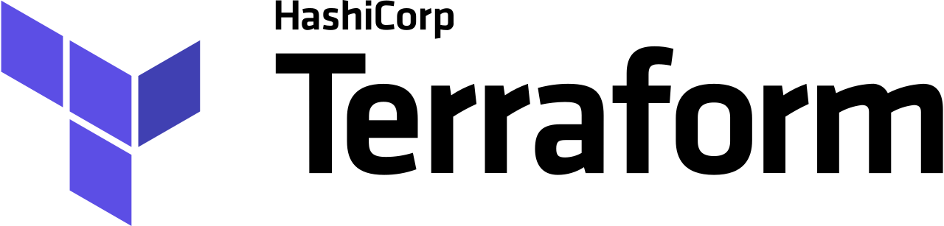
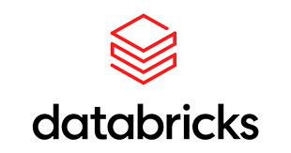

Build with a robust ecosystem
Frontend
Models (Compatible with any Model)
Frameworks
Observability
(Soon)
Clouds
IaC
Data Sources

Slide 12
Use Cases

Slide 13
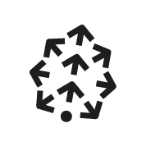
Keeping it simple—search like you mean it
We Take Data…
And We Deliver Delightful Experiences
Semantic Search
Retrieval Augmented Generation (RAG)
Question Answering
Enhanced Data Classification
Text
Images
Voice
Video
Documents

Slide 14
Early movers adopted Pinecone to meet this new paradigm shift
Notion picked Pinecone where it could scale Notion Q&A to millions of users at 7 Billion embeddings while remaining performant and cost-effective
Gong partners with Pinecone allowing them to track millions of conversations at 5 Billion embeddings while being cost-effective
Frontier Medicines transforms drug discovery by generating molecular insights with Pinecone serverless with tens of billions of vectors
74%
cost-savings
10x
cost-savings
98%
cost-savings

Slide 15
Demo
GitHub Repo: https://github.com/brickj/pinecone_starter_v1

Slide 16

What are you building?
Try Pinecone

